Slide 1

iTandem
HARVARD-WESTLAKE CARPOOL TANDEM FINDER
Daniel Baek
HONORS TOPICS

Slide 2

Problem
1
Wasted money on underutilized parking
2
Insufficient carpool & tandem coordination
3
Information asymmetry in spot selection
ITANDEM
3

Slide 3



Solution
Centralized matching platform
Data-driven spot intellegience systems
Peer-to-peer rental marketplace
ITANDEM
4

Slide 4
Services Overview
Smart carpool matching
Tandem partner finder
Parking spot rental marketplace
Spot intellegience & rankings
ITANDEM
6

Slide 5
UI

Slide 6
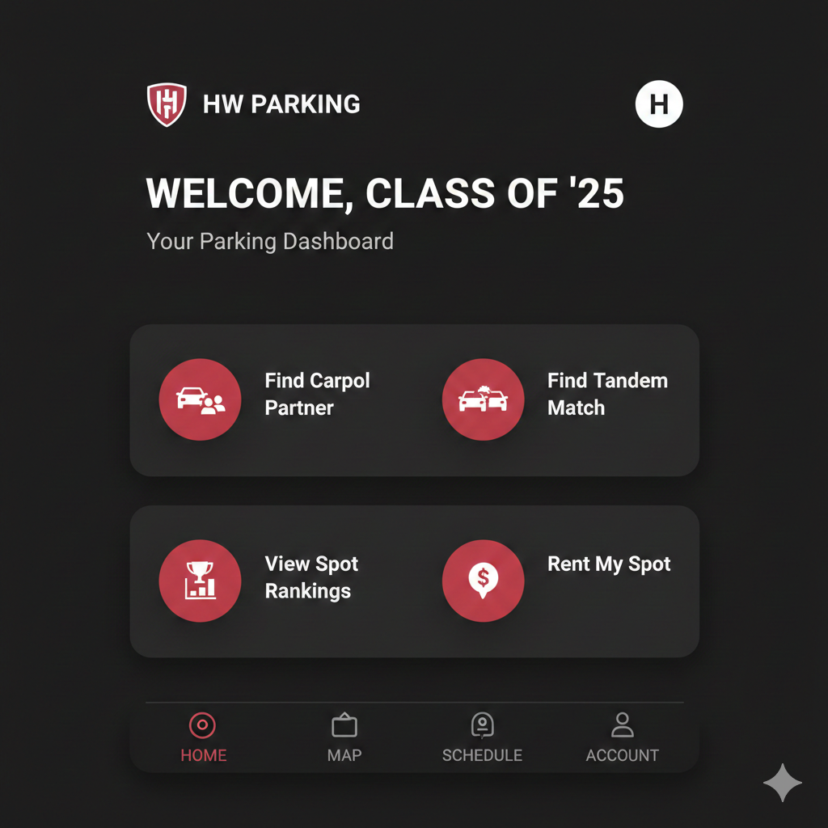

Slide 7
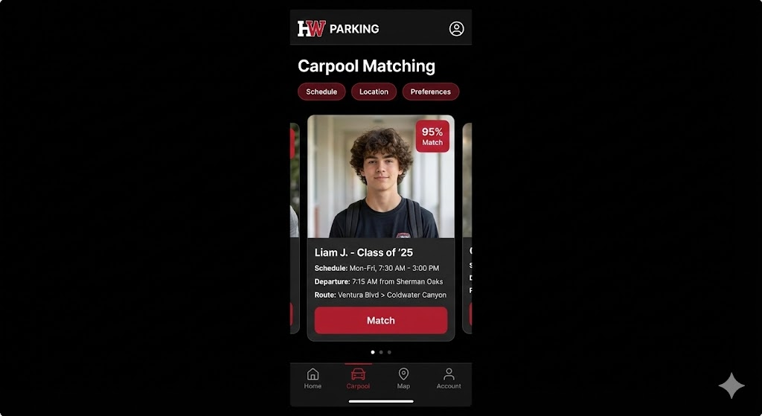

Slide 8
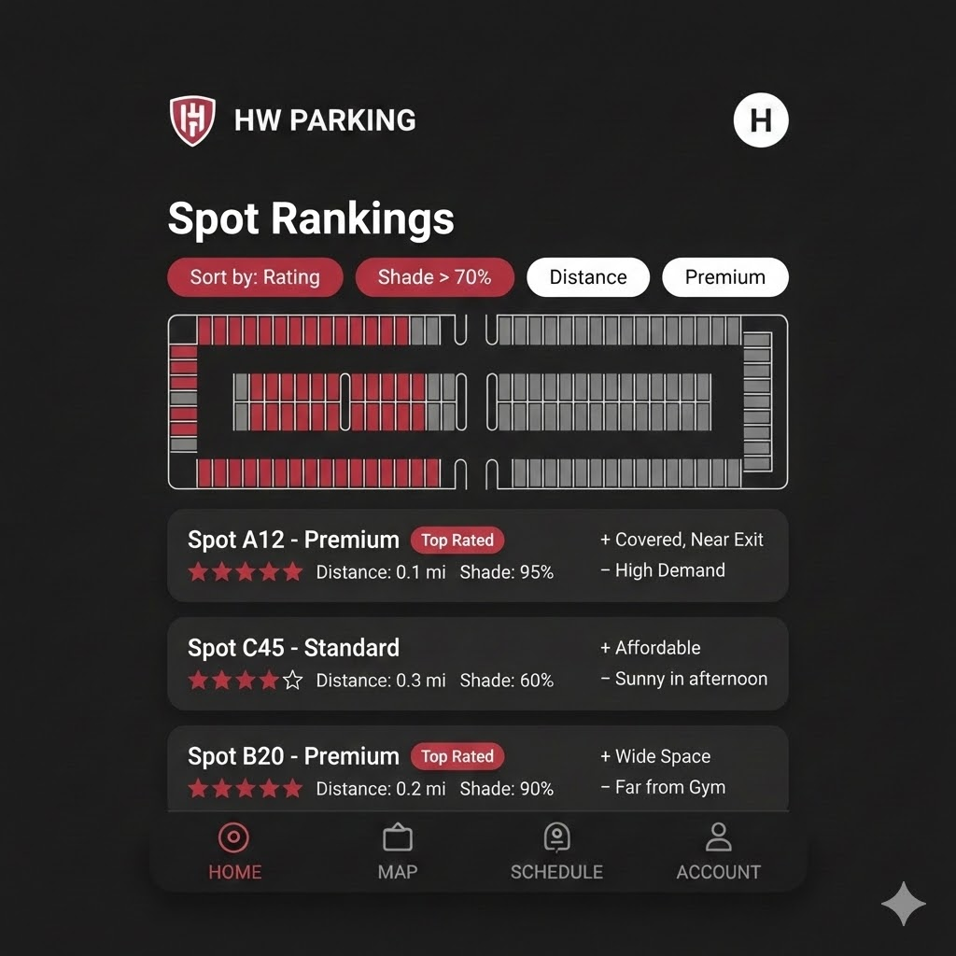

Slide 9
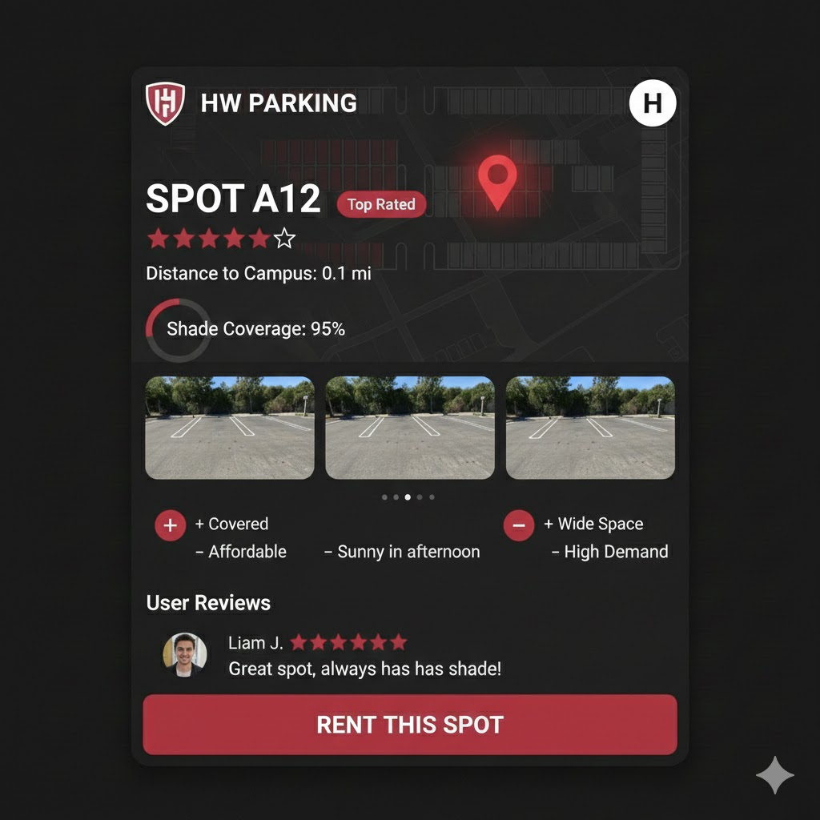

Slide 10
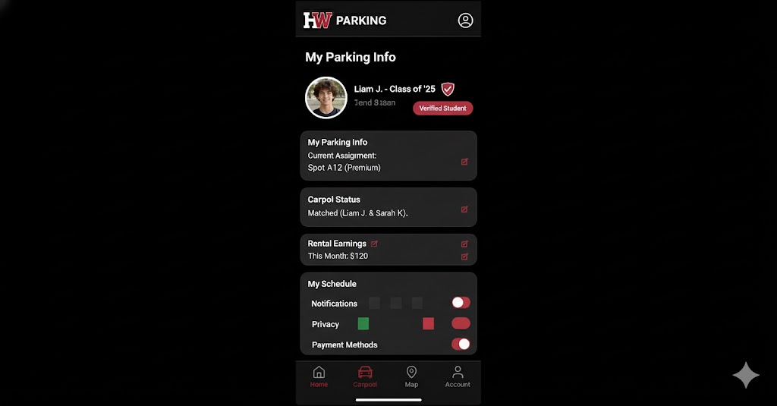

Slide 11
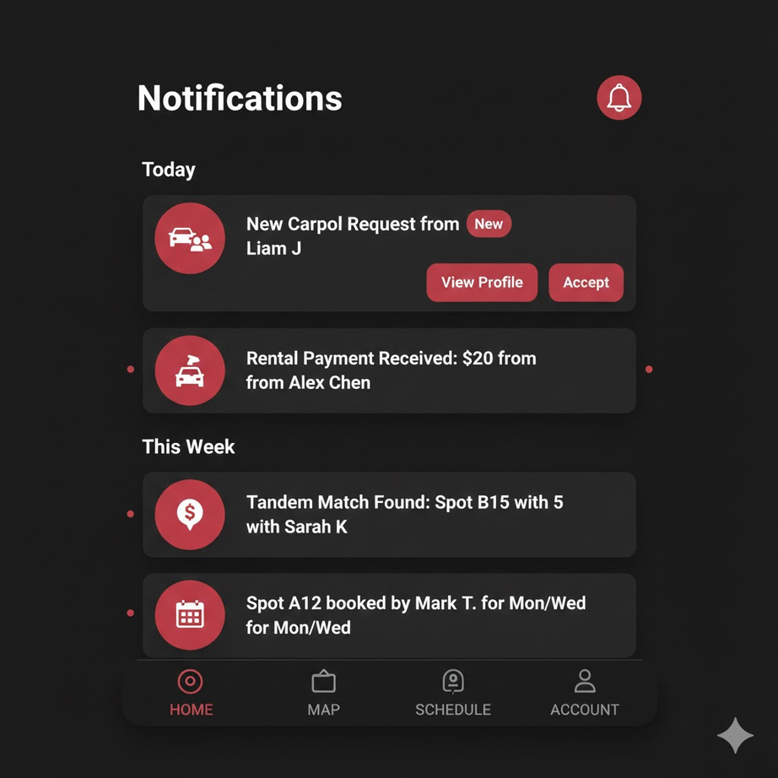

Slide 12
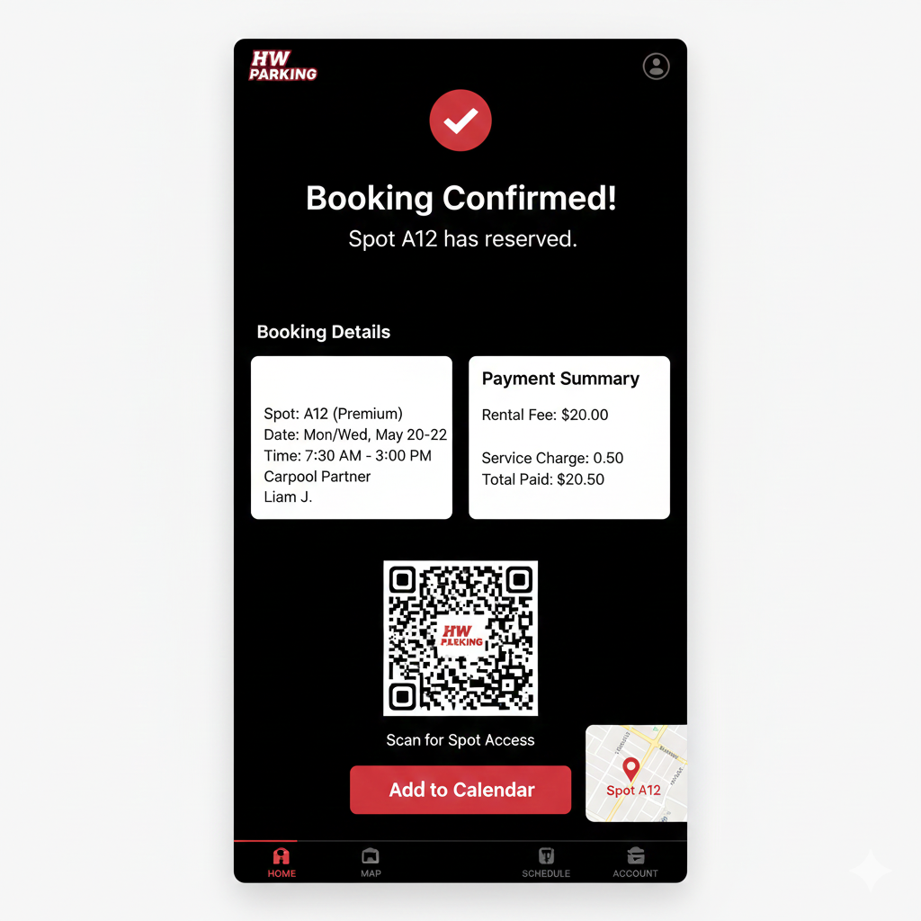

Slide 13
The End
THE END
The End
THE END

